Slide 1






















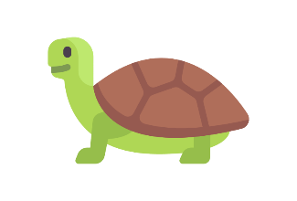
Dive into Open Source
Exploring the Ocean of Open Source
With Mozilla Punjab

Slide 2
Two-Day Event
23rd & 24th March
With an Aim to provide you a basic Training by organizing Hands-on Session on
Various technology during the Session.
10 AM - 4 PM
Lovely Professional University
Venue: Block 25-101

Slide 3
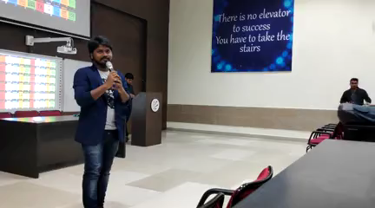
Agenda
Agenda
1. Getting Started with
Git and GitHub
5. React-Native vs Flutter
2. Cross Platform Web
Extensions
6. WebComponents–For Microfrontends
& Re-usable Components
3. Localization with Pontoon
7. UI/UX and Open Design
4. Kotlin/Native Magic of
Shared Code
8. Privacy and Advocacy

Slide 4
Agenda
1. Getting Started with
Git and GitHub
5. React-Native vs Flutter
2. Cross Platform Web
Extensions
6. WebComponents–For Microfrontends
& Re-usable Components
3. Localization with Pontoon
7. UI/UX and Open Design
4. Kotlin/Native Magic of
Shared Code
8. Privacy and Advocacy

Slide 5

punjab

